Slide 1
Lecture No. 33 Metallurgy
At the end of this lecture, students will be able to:
Explain the manufacture of steel
Discuss varieties of steel
Describe the properties and uses of steel

Slide 2
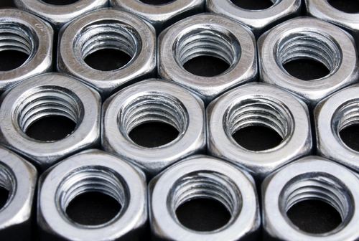
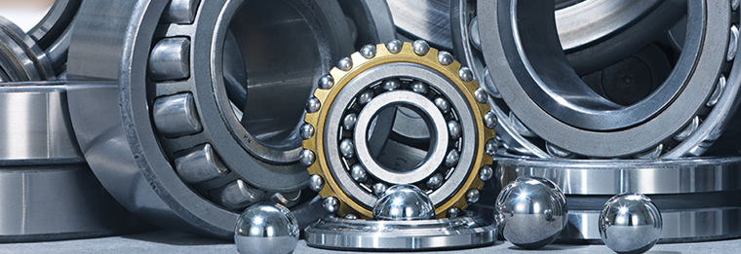
Steel
Steel is an alloy of iron with 0.25 5 to 2.5 % of carbon
Fe₃C (cementite) is the form of carbide present in steel
S, P, Si, Mn are the other impurities in steel
Steel is an intermediate product between cast iron and wrought iron when amount of carbon is taken into account
Cast iron or wrought iron can be used to manufacture steel

Slide 3
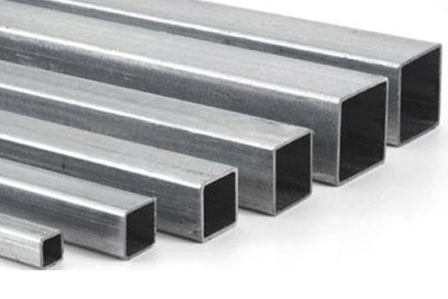
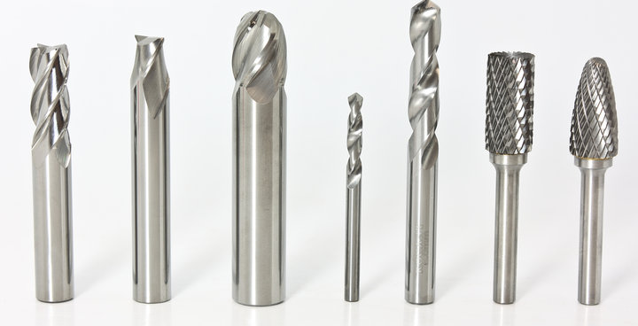
Varieties of steel
Mild steel:
Contains lower percentage of carbon
When mild steel is heated at high temperatures and quenched in oil or water it becomes hard and brittle
Exhibits properties of wrought iron and has elasticity and hardness of steel
Hard steel:
Contains higher percentage of carbon compared to mild steel
Hard steel is hard and brittle like glass
Usually heated and quenched to prepare hardened steel

Slide 4
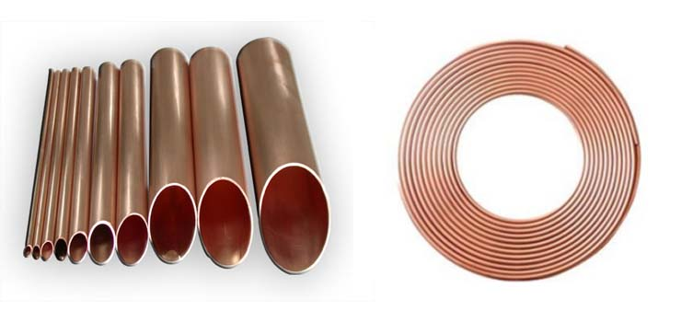
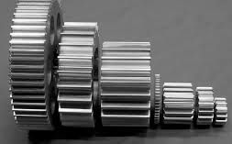
Varieties of steel
Special steels or alloys:
Addition of other elements such as Co, Ni, Mn, Si, P etc. can change the properties of steel
Hardness, corrosion resistance, expansion coefficient , brittleness are some of such properties
They are known as special steels or alloys
Steel containing more ‘P’ is brittle when cold
Steel containing more ‘S’ is also brittle when hot

Slide 5
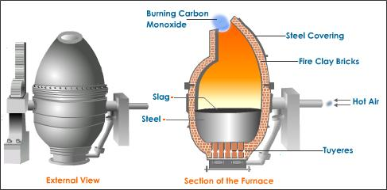
Production of Steel
Bessemer’s process:
Bessemer’s converter is used for the production of steel
Pear shaped vessel which has many holes to admit hot air
Converter is mounted on pivots which makes tilting possible
Depending on the type of impurities present in cast iron this process is classified into two types, (i) acidic Bessemer’s process, (ii) Basic Bessemer’s process

Slide 6
Production of Steel
Acidic Bessemer’s process:
If cast iron contains Si and Mn impurities this method is preferred
Cast iron is free from phosphorous and sulphur impurities
Interior is lined with SiO₂
Converter is charged with cast iron and hot air is blown from the bottom
Si and Mn impurities react with oxygen and form their respective oxides and further they for the slag which is eliminated to get steel
$$Si+ O_{2} →SiO_{2}$$
$2Mn+ O_{2} →MnO$
$$SiO_{2}+MnO →MnSiO_{3} (slag)$$
Some carbon dissolves in molten metal to form steel and rest is oxidized to CO

Slide 7
Production of Steel
Basic Bessemer’s process:
If phosphorous impurity is present this method is preferred
Interior is lined with CaO (lime)
Phosphorous is oxidized to its oxide and the converted as slag and removed to get pure steel
$$4P+5O_{2} →2P_{2}O_{5}$$
$$3CaO+P_{2}O_{5} →Ca_{3}(PO_{4})_{2} (slag)$$
Finally the converter is tilted and molten steel is poured out
It is quick and inexpensive process

Slide 8
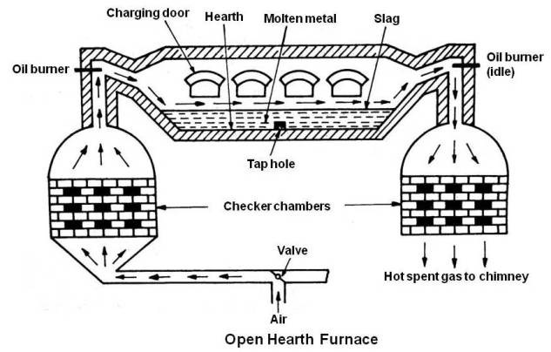
Production of Steel
Open-hearth process:
Open hearth furnace is used to produce steel where hot air/gases are coming from the bottom and the heat is utilized by the furnace
Charge consists of cast or pig iron, scrap iron and haematite ore
Charge is melted by heating with the hot air & burning gaseous fuels
Oxidized impurities form the slag which can be removed

Slide 9
Production of Steel
Acidic process:
Furnace hearth is lined with SiO₂ and charge consists of impurities like Si and Mn
$2Fe_{2}O_{3} +3Si →4Fe+3SiO_{2}$
$$Fe_{2}O_{3} +3Mn →2Fe+3MnO$$
$$SiO_{2}+MnO →MnSiO_{3} (slag)$$
Slag is removed and pure steel is obtained
If any excess impurities like sulphur or carbon is present they are oxidized to their respective oxides and eliminated

Slide 10
Production of Steel
Basic process:
If phosphorous impurities are present this method is preferred
Furnace hearth is lined with lime CaO or dolomite CaO.MgO
Phosphorous impurities are oxidized to P₂O₅ and then react with silica to form slag
Slag can be removed and pure steel can be separated
$$5Fe_{2}O_{3} +6P →10Fe+3\text{P}\text{2}\text{O}\text{5}$$
$$3CaO+P_{2}O_{5} →Ca_{3}(PO_{4})_{2} (slag)$$

Slide 11
Comparison of Bessemer & Open Hearth Processes
Bessemer’s process | Open hearth process
1. Oxidation of impurities is carried out by hot blast of air 2. Restricted to pig iron of a particular composition 3. Temperature can not be controlled very well 4. Process is not continuous 5. Steel is not of good quality 6. It is quick and takes 10-15 minutes 7. Loss of iron is more | Oxidation of impurities is carried out by Fe₂O₃ It is adapted to pig iron of any composition Temperature can be controlled very well Process is continuous Steel is of uniform and better quality It is slow and takes several hours Loss of iron is less

Slide 12
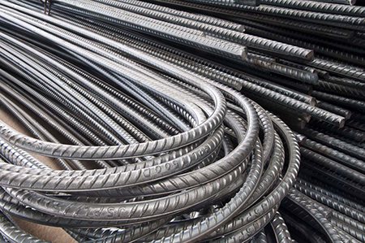
Properties of Steel
Steel is an alloy of iron and carbon which is an intermediate composition between cast iron and wrought iron
Contains traces of S, P, Mn, Si etc.
It can be forged and welded
It exhibits combination of properties of cast iron and wrought iron
It is hard and elastic
Properties can be modified by the addition of impurity elements, for e.g., Mn increases the hardness and tensile strength of steel

Slide 13
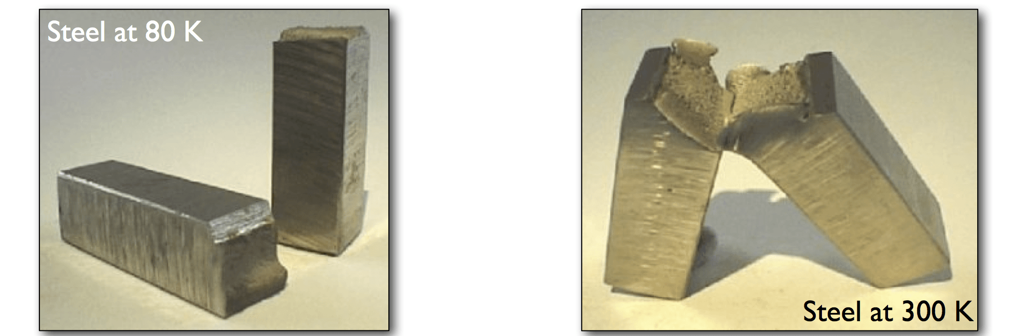
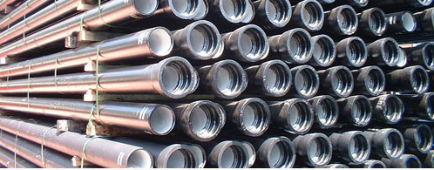
Properties of Steel
When steel is heated and cooled slowly it becomes ductile
When steel is heated and quenched it becomes hard and brittle
Annealed or quenched steel can be heated and cooled slowly to get tempered steel which is used to make variety of hardware and tools
Mild steel is heated with charcoal to get case hardened steel which is resistant to wear and tear
If steel is heated with dry NH₃ it forms a coating of iron nitride

Slide 14
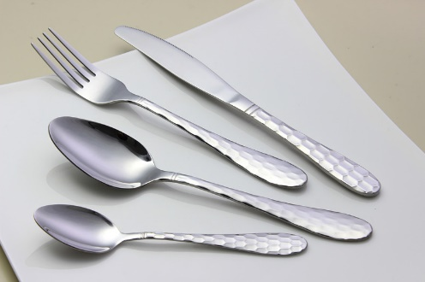
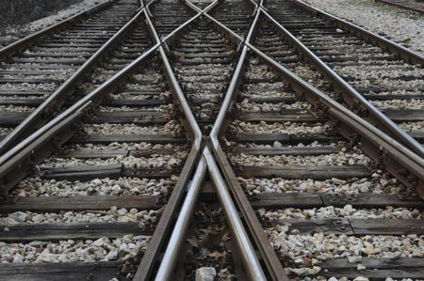
Uses of Steel
Used for the manufacture of utensils, knifes etc.
Can be used to make magnets and magnetic needles
Useful to make surgical instruments, engines and cranes
Used to make train compartments, axles etc.
Storage tanks are made of steel

Slide 15

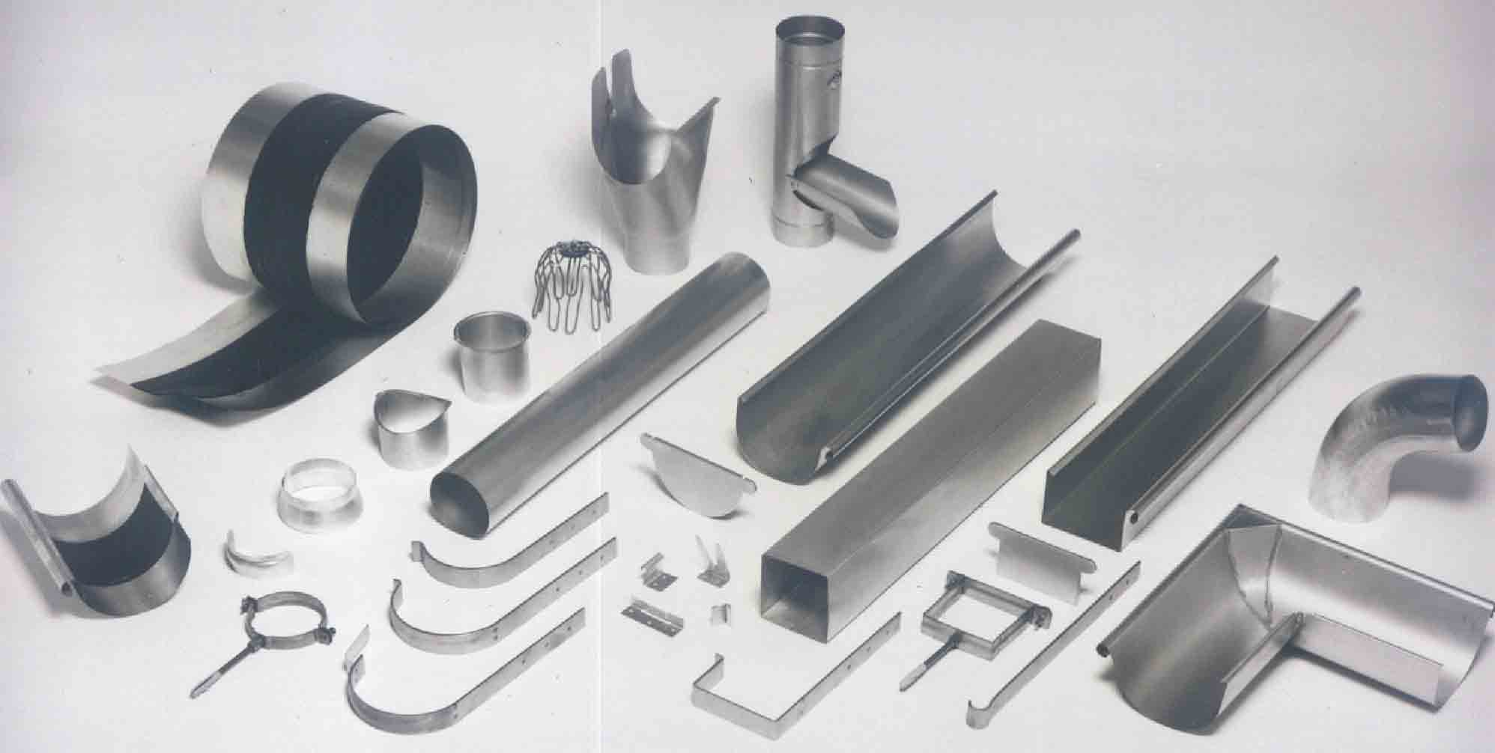
Uses of Steel
Car bodies, electrical appliances can be made of steel
building products like steel roofs and frames are used extensively
Useful in food storage and packing material production
Steel is commonly used to build large bridges

Slide 16
Summary
Steel is an alloy of iron with 0.25 5 to 2.5 % of carbon
S, P, Si, Mn are the other impurities in steel
Bessemer’s converter is used for the production of steel. Acidic and basic processes help to eliminate impurities
Open hearth process is also useful for steel production and has more advantages than Bessemer’s process
Steel is useful in the production of building materials, utensils, hardware, tools, packing materials etc.

